Slide 1
IA Aging Inventory Report
[SDS](SDSIT)[SP-sui] 26-SEP-2016
(TDSC)(IT)[ME-sui] 17-JAN-2018 Upd.
開示範囲 | ［SDS社］限り
情報オーナー部門長 | （SDSIT）[SP推]長
取扱い制限 | 無断複製・無断転載禁止

Slide 2
Agenda
IA Aging Inventory report
View of the report
Creating procedure
Application flow and relationship with Monitoring DB

Slide 3
IA Aging Inventory report
View of the report

Slide 4
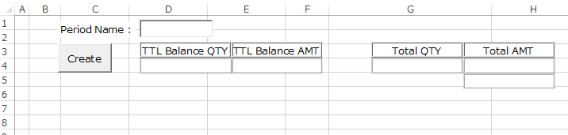
IA Aging Inventory report
Creating procedure
Excel file has 4 sheets. Basically only “Summary” sheet is used.
“Summary” sheet
“Data” and “Scope” sheet
Please ignore because it is work sheet to be used when report created.
Entered in MON-YYYY format to “Period Name”, please click the [Create] button. Then, to wait for a while. The report will be created automatically.
(Note) In order to connect to ORACLE database, requires PC ORACLE client is installed.

Slide 5
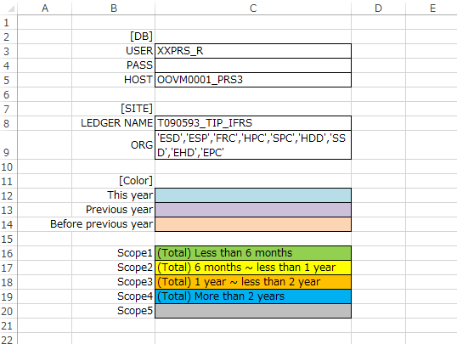
IA Aging Inventory report
Creating procedure
“Setup” sheet
[DB] is ORACLE database connection information. You do not need to change. However, please fill in the DB name that is described in the TNSNAMES.ORA to “HOST”.
[SITE] is condition to extract data. Please add If target organization has increased.
[Color] is used to indicate the report title. You do not need to change.

Slide 6
IA Aging Inventory report
Application flow and relationship with Monitoring DB
IAS_BALANCE_HST
IAS_BALANCE
Actual Table →
① Data will be create in concurrent program “IASS_Monthly16 Create Monthly Report”.
IAS_BALANCE_HST_VPD_V
IAS_BALANCE_VPD_V
MOAC View →
IAS_BALANCE_HST
IAS_BALANCE
Synonym →
IASS0410
IAS_IMMOBILITY
_STOCK_HST
IAS_IMMOBILITY
_STOCK
③ Execute the concurrent program "IASS_Monthly17 Monitoring DB Connection", then text file creation and file transfer.
② Create EXCEL report, and confirm.
IASS0416
Aging
Inventory
Report
Text File
[SDS]
Monitoring DB
Same data
ftp
xxia_monitoring_send_tip

Slide 7
IA Aging Inventory report
Added
Application flow and relationship with Monitoring DB
IAS_BALANCE_HST
IAS_BALANCE
Actual Table →
IAS_BALANCE_HST_VPD_V
IAS_BALANCE_VPD_V
① Data will be create in concurrent program “IASS_Monthly16 Create Monthly Report”.
MOAC View →
IAS_BALANCE_HST
IAS_BALANCE
Synonym →
IAS_BALANCE_CNV_HST_V
IAS_BALANCE_CNV_V
It creates newly for P-G PJ.
P-G Convert View →
IASS0410
IAS_IMMOBILITY
_STOCK_HST
IAS_IMMOBILITY
_STOCK
③ Execute the concurrent program "IASS_Monthly17 Monitoring DB Connection", then text file creation and file transfer.
② Create EXCEL report, and confirm.
IASS0416
Aging
Inventory
Report
Text File
[SDS]
Monitoring DB
Same data
ftp
xxia_monitoring_send_tip

Slide 8
Logic Summary
Added
Start
Create Aging report data (IASS0410)
1
1. Get accounting period from IA parameter master.
2. Get devaluation parameter from IA setup master.
3. Aging report data of accounting period is deleted.
4. Cursor open IA balance of accounting period.
Current balance <> 0 is extracted. However, exclusion condition set to the IA setup master is not extracted.
4-1. If Receiving >0 or old balance=0, go to 4-2. Other than, fetch past IA balance (go to 5).
Old balance = Old balance of previous month - Receiving.
4-2. Register to Aging report data.
ORIGINAL_MONTH ← Accounting period
ELAPSED_MONTHS ← 0
4-3. If old balance=0, go to 4. Other than, go to 5.
5. Cursor open past IA balance data
cursor which combined IAS_BALANCE and IAS_BALANCE_HST. Accounting period is sorted by descending order.
5-1. If Receiving >0 or Old balance=0, go to 5-2. Other than, fetch more past IA balance.
Old balance = Old balance of previous month - Receiving.
5-2. Register to Aging report data.
ORIGINAL_MONTH ← Accounting period of past IA balance
ELAPSED_MONTHS ← Accounting period - Accounting period of past IA balance
5-3. If old balance=0, go to 4. Other than, go to 5.
5-4. Register to Aging report data.
ORIGINAL_MONTH ← ’000000’
ELAPSED_MONTHS ← 999
2
3
4
Count 0
N
4-1
Y
4-2
N
4-3
Y
5
Count 0
N
5-1
Y
5-2
N
5-3
Y
5-4
End

Slide 9
Monitoring DB
Added
File transfer specification
1. Connection user
Live env. Test env.
Yokohama & TIP common pfsps tfsps
2. Directory
~/in/SDW/SEITANA
3. File Type : Text
File name : TANA_”Site”+”1”_YYYYMMDDHH24MISS.dat
ex) TANA_TIP1_YYYYMMDDHH24MISS.dat
TANA_TIP1_YYYYMMDDHH24MISS.dat.RES (0byte possible)
4. Data Rule
a. Variable-length file
b. Delimiter “|”
c. Header line is no need.
d. Less than delimiter is not enclosed by "".
e. Date type format is “yyyy/mm/dd hh24:MI:SS”
ex) |2016/02/02 01:00:00|
5. Data format

Slide 10









Slide 11
[SDS]Monitoring of Inventory System Image
◆ Toshiba Inte
5 FA
Yokka-
ichi
Hime
-Han
Yoko
hama
ftp(GSS)
HQ
Report
・Graph
Oita
MC
Evaluate
Journal
◆ Toshiba Grp
Closing
8 FA
［SDSkei]
JSC
Oita
Iwate
Kaga
Buzen
Toshiba
Hime-
To
TST
TMEC
Monitoring DB
ftp(GSS)
Evaluate
(AI-tou)
Journal
TIP
NFT
(Mail)
Affiliate
Division
Closig
Group
Notes:
6月末在庫の評価が次回のターゲット。

